Slide 1

Matyáš Prokop
Principle Architect, Natilik
Starting off as a founder of Bubakov.net (a community-led ISP) whilst still in his teens, seeing the potential of a good network, is in Matyas’ DNA. He has since designed data centers at Google and now stands as Principal Architect at Natilik focusing on service providers, datacenters and DevOps. Alongside this he organizes Network Automation Meet-Ups in London, constantly pushing boundaries and supporting this ever-evolving and exciting industry.

Slide 2
Deep Learning with TensorFlow
Matyáš Prokop
Principle Architect, Natilik
@maty0609

Slide 3
Agenda
How did we get here?
Introduction to TensorFlow
TensorFlow, TensorFlow Lite
Data models and Datasets
TensorFlow and car recognition
What can we improve?

Slide 4
What do we want to build?
Car recognition
Car plate recognition
Reading of a car plate
Sending data to a database

Slide 5
What do we need?
Raspberry Pi
Camera
Data set
GPU

Slide 6
Introduction to TensorFlow
Developed by Google
Used by Google, Uber, Spotify
Object Detection, Text Classification, Face Recognition
Once training is done TensorFlow can be run on many different platforms
Incorporates different API to built at scale deep learning architecture like CNN or RNN

Slide 7
How to build a Data Model? Go big!
We need a HUGE data set
We need a LOT of GPU
We need a LOT of time
TensorFlow needs to be compiled and installed

Slide 8
What is a Dataset?
Large collection of small pictures
Various angles, scales, noise levels, picture qualities and object sizes
Pictures are named and annotated
Test and training pictures
Notes:
Your neural network is only as good as the data you feed it

Slide 9
How to improve a Dataset? Data Augmentation!
Smaller sizes of pictures
Increasing diversity
Cropping, padding and horizontal flipping
Adding noise to the pictures
Notes:
Our optimization goal is to chase that sweet spot where our model’s loss is low
It finds the most obvious features that distinguishes one class from another
https://nanonets.com/blog/data-augmentation-how-to-use-deep-learning-when-you-have-limited-data-part-2/

Slide 10
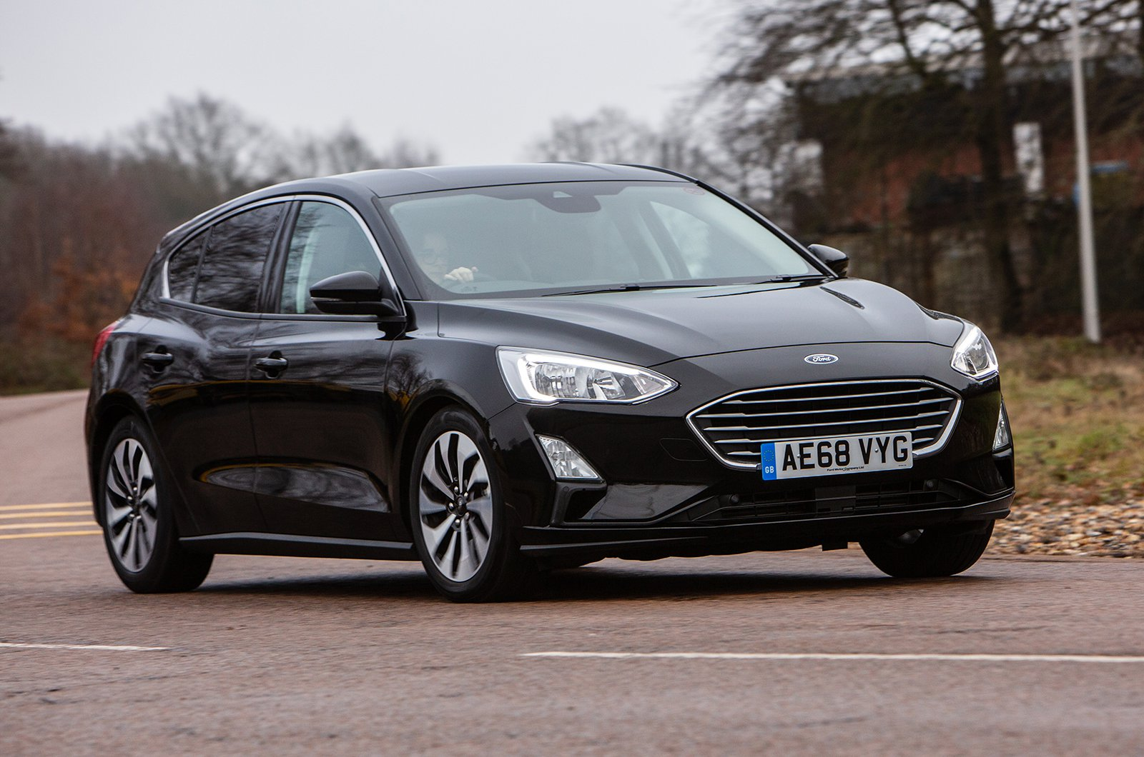
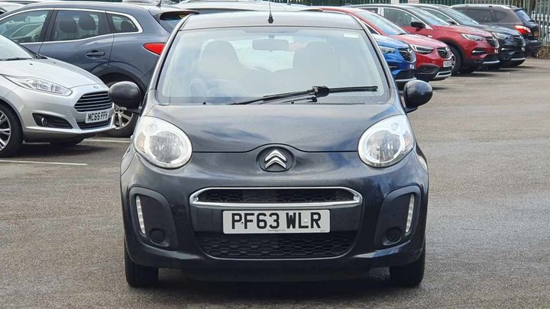
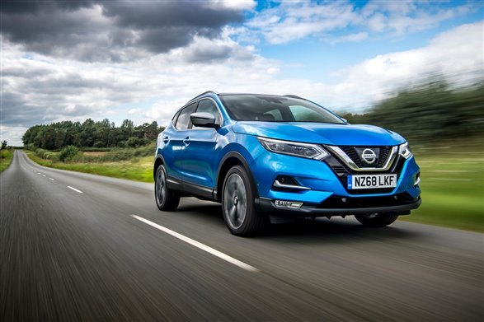
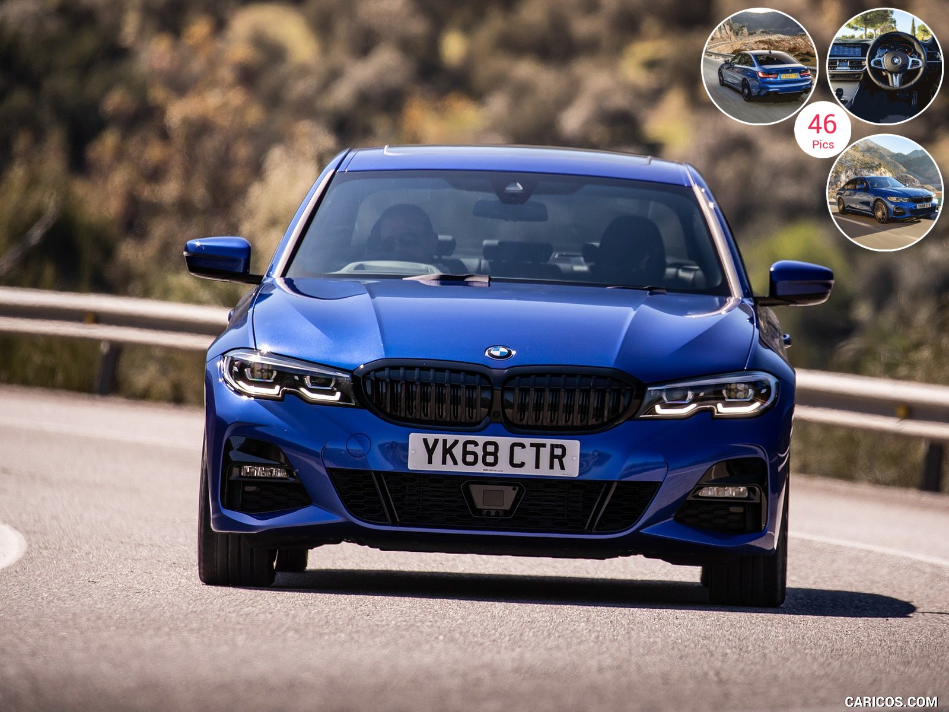
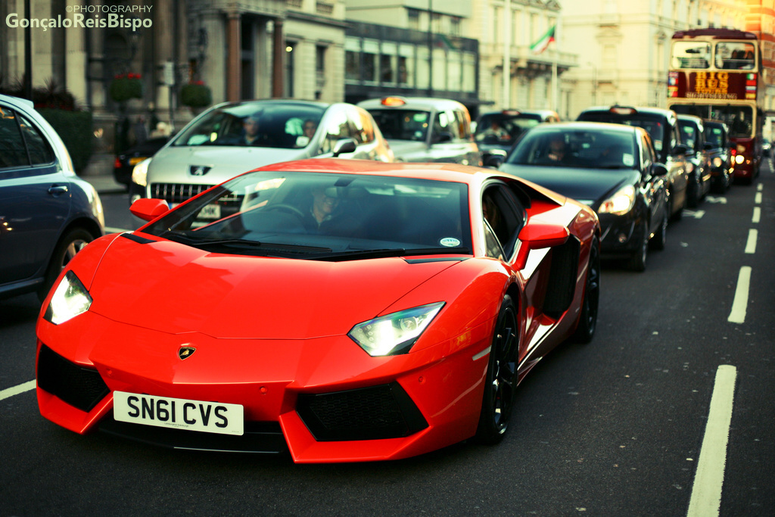
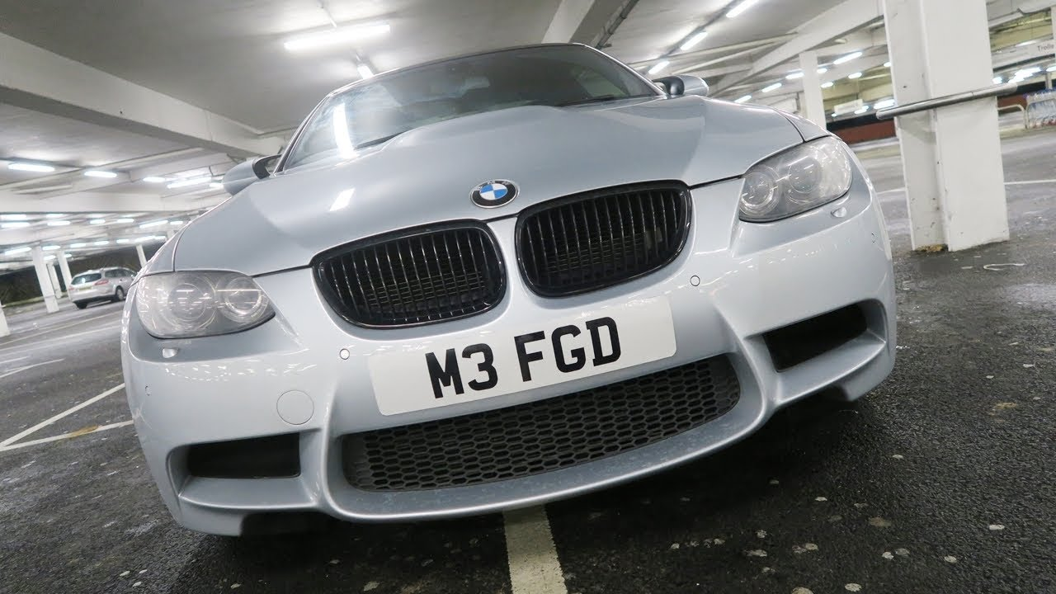
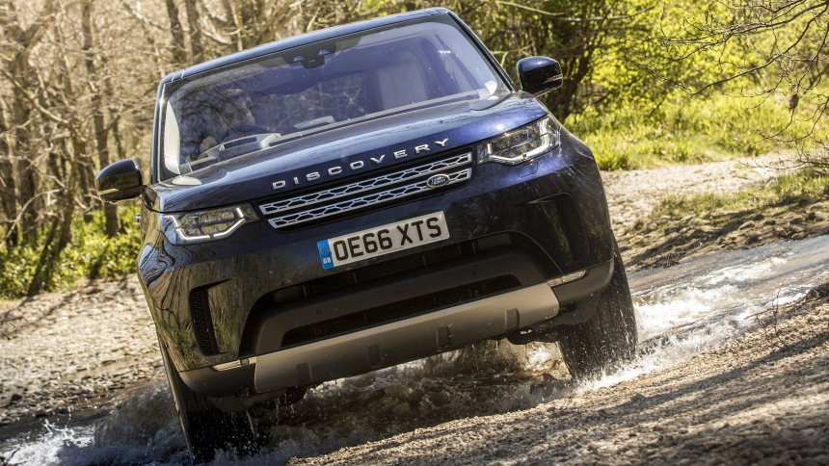
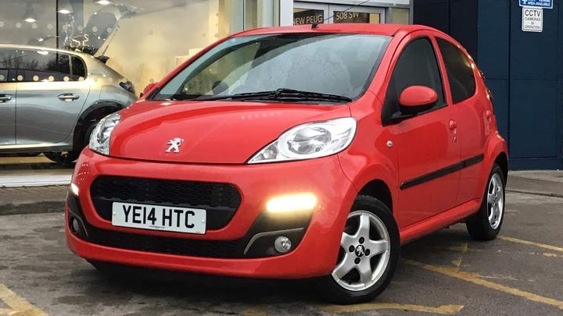
What does a Dataset look like?
Notes:
Your neural network is only as good as the data you feed it

Slide 11
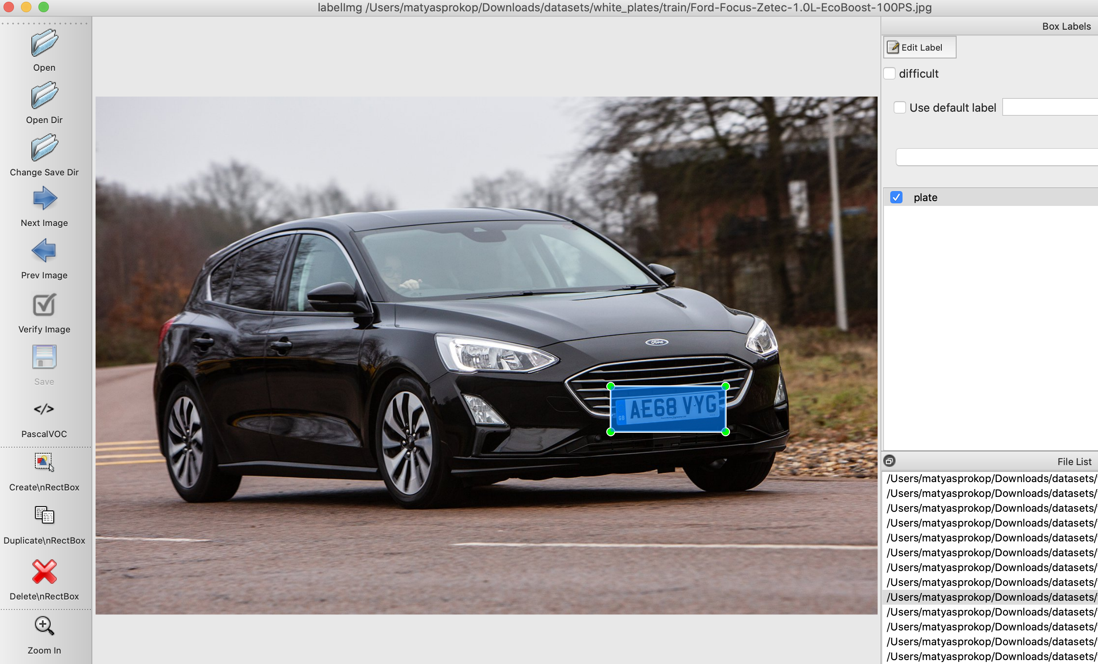
Annotations
Notes:
Our optimization goal is to chase that sweet spot where our model’s loss is low
It finds the most obvious features that distinguishes one class from another
https://nanonets.com/blog/data-augmentation-how-to-use-deep-learning-when-you-have-limited-data-part-2/

Slide 12
How to build a Data Model?
Upload the Dataset including annotations
Pre-install TensorFlow and TensorFlow models
Use an object detector
Run the Dataset through the TensorFlow model
Export the model to SSD
Notes:
TensorFlow Lite does NOT support RCNN models such as Faster-RCNN! It only supports SSD models

Slide 13
Choosing an Object Detector. And the winner is...
SSD with MobileNet provides the best accuracy trade-off within the fastest detectors.
SSD is fast but performs worse for small objects when compared to others.
For large objects, SSD can outperform Faster R-CNN and R-FCN in accuracy with lighter and faster extractors.
Source: https://medium.com/@jonathan_hui/object-detection-speed-and-accuracy-comparison-faster-r-cnn-r-fcn-ssd-and-yolo-5425656ae359
Notes:
TensorFlow Lite does NOT support RCNN models such as Faster-RCNN! It only supports SSD models
The most important question is not which detector is the best. It may not possible to answer. The real question is which detector and what configurations give us the best balance of speed and accuracy that your application needed.

Slide 14
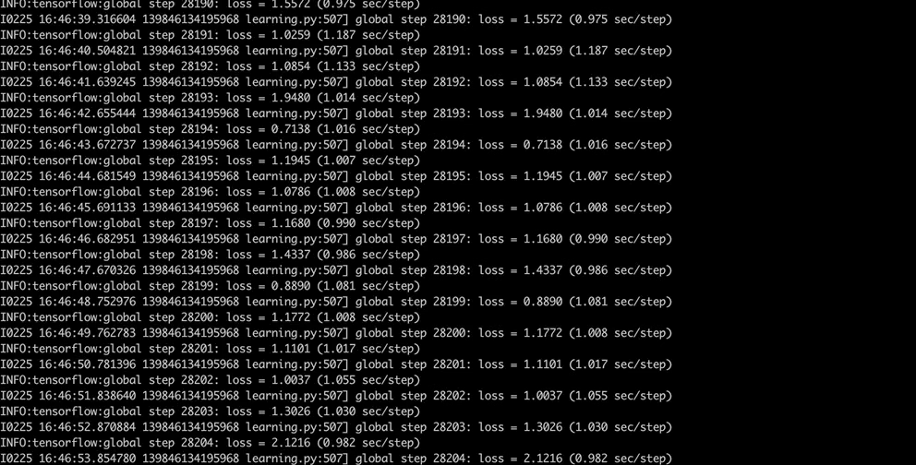
Building a Data Model

Slide 15
Real stuff: Building and converting a TensorFlow model to TFLite
git clone https://github.com/tensorflow/models
cd research/object_detection/
# Download SSD Mobilenet V2 – Object detector
wget http://download.tensorflow.org/models/object_detection/ssd_mobilenet_v2_quantized_300x300_coco_2019_01_03.tar.gz
# Extract Object Detector
tar xzvf ssd_mobilenet_v2_quantized_300x300_coco_2019_01_03.tar.gz
# Start training the model
python3 train.py --logtostderr --train_dir=training/ --pipeline_config_path=training/ssd_mobilenet_v2_quantized_300x300_coco.config
# Exporting the model to freeze graph
python3 export_tflite_ssd_graph.py --pipeline_config_path=$CONFIG_FILE --trained_checkpoint_prefix=$CHECKPOINT_PATH --output_directory=$OUTPUT_DIR --add_postprocessing_op=true
cd ~/tensorflow
# Converting freeze graph to TFLite
bazel run -c opt tensorflow/lite/toco:toco -- --input_file=$OUTPUT_DIR/tflite_graph.pb --output_file=$OUTPUT_DIR/detect.tflite --input_shapes=1,300,300,3 --input_arrays=normalized_input_image_tensor --output_arrays=TFLite_Detection_PostProcess,TFLite_Detection_PostProcess:1,TFLite_Detection_PostProcess:2,TFLite_Detection_PostProcess:3 --inference_type=QUANTIZED_UINT8 --mean_values=128 --std_values=128 --change_concat_input_ranges=false --allow_custom_ops

Slide 16
Putting all things together
python3 TFLite_detection_webcam.py --modeldir=tflite_graphs/plates

Slide 17
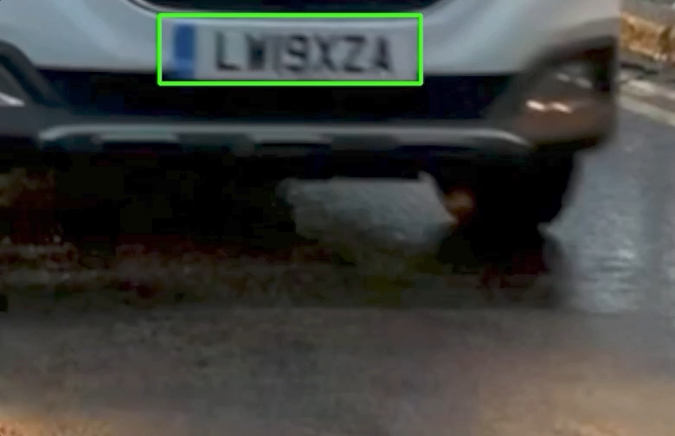
Car Plate Detection

Slide 18

Car Plate Recognition
OCR after car plate detection
Using OpenCV2 and Google’s Tesseract
Using UK car plate font

Slide 19
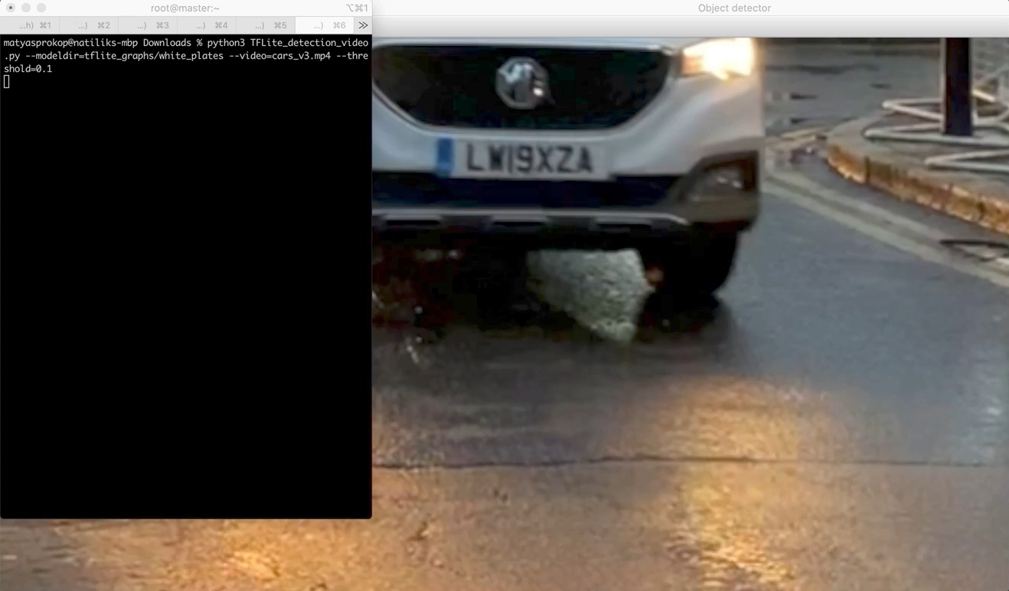
Car Plate Recognition

Slide 20
Summary
Running on Raspberry Pi
Recording cars with a camera
Car plate recognition with TensorFlow Lite
Reading car plates with Google’s Tesseract
Sending the car plate details to the API

Slide 21
What can be improved?
High resolution camera
TensorFlow for OCR
Edge GPU accelerator

Slide 22
Links
https://git.matyasprokop.com/mprokop/devnetcreate2020
https://twitter.com/maty0609
https://www.linkedin.com/in/matyasprokop/

